Slide 1

B.TECH MAJOR PROJECT · MANIPAL UNIVERSITY JAIPUR
Design and Development of AI-Driven Scalable Enterprise Applications
Data-Driven Scheme Planning Platform — Simplify Scheme
Student: Gaurav Kumar(229301259) · B.Tech CSE · Guide: Mrs. Tripti Kulshrestha · Organization: Simplify Consulting (India) Pvt. Ltd.

Slide 2

PROJECT OVERVIEW
What is Simplify Scheme?
Simplify Scheme is an AI-powered enterprise platform designed to modernize dealer incentive management for large-scale distribution networks. It replaces manual, error-prone processes with intelligent automation, predictive analytics, and real-time decision support — enabling organizations to plan, track, and optimize incentive schemes at scale.
299+
14+
KPIs Tracked
ML Models
Comprehensive performance indicators across dealer operations
Specialized models for churn, performance, and forecasting
3
Core Pillars
Scheme planning, KPI tracking, and AI decision support

Slide 3

MOTIVATION
Why This Project?
Traditional dealer incentive management relies on static, manual processes that cannot keep pace with dynamic market conditions. Organizations face significant operational inefficiencies, revenue leakage, and missed opportunities due to a lack of intelligent automation.
The Core Challenge
What the Market Needs
Manual incentive scheme planning is slow, error-prone, and resource-intensive. Static rule-based systems fail to adapt to evolving dealer behavior, seasonal trends, or competitive dynamics — resulting in suboptimal budget allocation and reduced dealer engagement.
Predictive analytics to anticipate dealer churn and performance shifts
Automated scheme creation and validation workflows
Scalable architecture capable of handling enterprise-grade data volumes
Real-time fraud detection and anomaly monitoring
AI-assisted decision-making for scheme designers and managers

Slide 4
PROBLEM STATEMENT
Limitations of Existing Approaches
Current dealer incentive management relies on fragmented tools — spreadsheets, legacy ERPs, and manual reporting — that lack the intelligence, speed, and scalability required for modern enterprise operations.
No Predictive Intelligence
No Dynamic Optimization
Excel and ERP systems are reactive by design. They record what happened but cannot forecast what will happen — leaving organizations unable to proactively manage dealer churn, performance dips, or budget overruns.
Static slab structures and fixed rules cannot adapt to real-time market signals. Incentive schemes remain unchanged even when dealer behavior, competition, or demand patterns shift significantly.
No Real-Time Fraud & Churn Detection
Scalability & Collaboration Gaps
Manual audits and periodic reviews allow fraudulent claims and dealer disengagement to go undetected for weeks. There is no automated mechanism to flag anomalies or trigger corrective actions in real time.
Spreadsheet-based processes break down at enterprise scale. Version conflicts, data silos, and lack of audit trails make it nearly impossible to manage schemes across hundreds of dealers and thousands of SKUs.

Slide 5
OBJECTIVES
Project Objectives
The project targets five interconnected objectives that collectively address the gaps in traditional incentive management — from predictive modeling and automation to real-time KPI tracking and AI-assisted decision-making.
1
2
3
Predict Dealer Churn & Performance
Automate Scheme Creation & Validation
Track KPIs in Real Time
Implement a unified KPI pipeline monitoring 299+ indicators across dealer networks, with live dashboards and automated alerts.
Build ML models to forecast dealer attrition risk and sales performance, enabling proactive intervention before revenue is lost.
Design intelligent workflows that generate, validate, and recommend incentive schemes based on historical data and business rules.
4
5
Optimize Budgets & Slabs
Support AI-Assisted Decision-Making
Apply optimization algorithms to dynamically adjust incentive slabs and budget allocations for maximum ROI and dealer motivation.
Deploy LLM-powered AI agents and a multi-agent copilot to provide contextual recommendations and natural-language insights to scheme designers.

Slide 6



PROPOSED SOLUTION
The AI-Powered Incentive Management Platform
Simplify Scheme delivers an end-to-end intelligent platform combining machine learning, large language models, and scalable microservices to transform how enterprises plan and manage dealer incentives.
ML Forecasting Engine
14+ specialized models predict dealer churn, sales trajectories, and scheme effectiveness — enabling data-driven proactive decisions.
Intelligent AI Agents
Multi-agent orchestration with LLMs and RAG pipelines provides contextual recommendations, anomaly explanations, and natural-language query support.
Automated Recommendations
Rule engines and optimization algorithms automatically suggest scheme parameters, slab thresholds, and budget reallocations based on live data.
Real-Time Analytics
Scalable microservices architecture with Redis caching and PostgreSQL ensures sub-second KPI updates and high-throughput data processing.

Slide 7
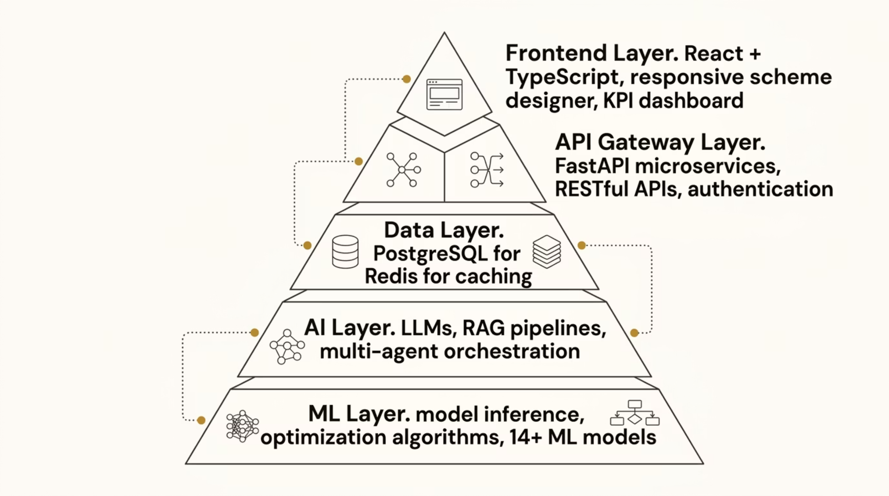

ARCHITECTURE
System Architecture
The platform follows a modern, layered microservices architecture designed for scalability, fault tolerance, and seamless AI integration. Each layer is independently deployable, enabling rapid iteration and enterprise-grade reliability.
Frontend & API Layer
Data, AI & ML Layer
React + TypeScript delivers a responsive, type-safe UI for scheme design and KPI visualization. FastAPI microservices expose RESTful endpoints with async support, enabling high concurrency and low-latency responses.
PostgreSQL handles structured transactional data; Redis provides in-memory caching for real-time KPI queries. The AI layer integrates LLMs with RAG for contextual reasoning, while the ML layer runs inference across 14+ trained models.

Slide 8
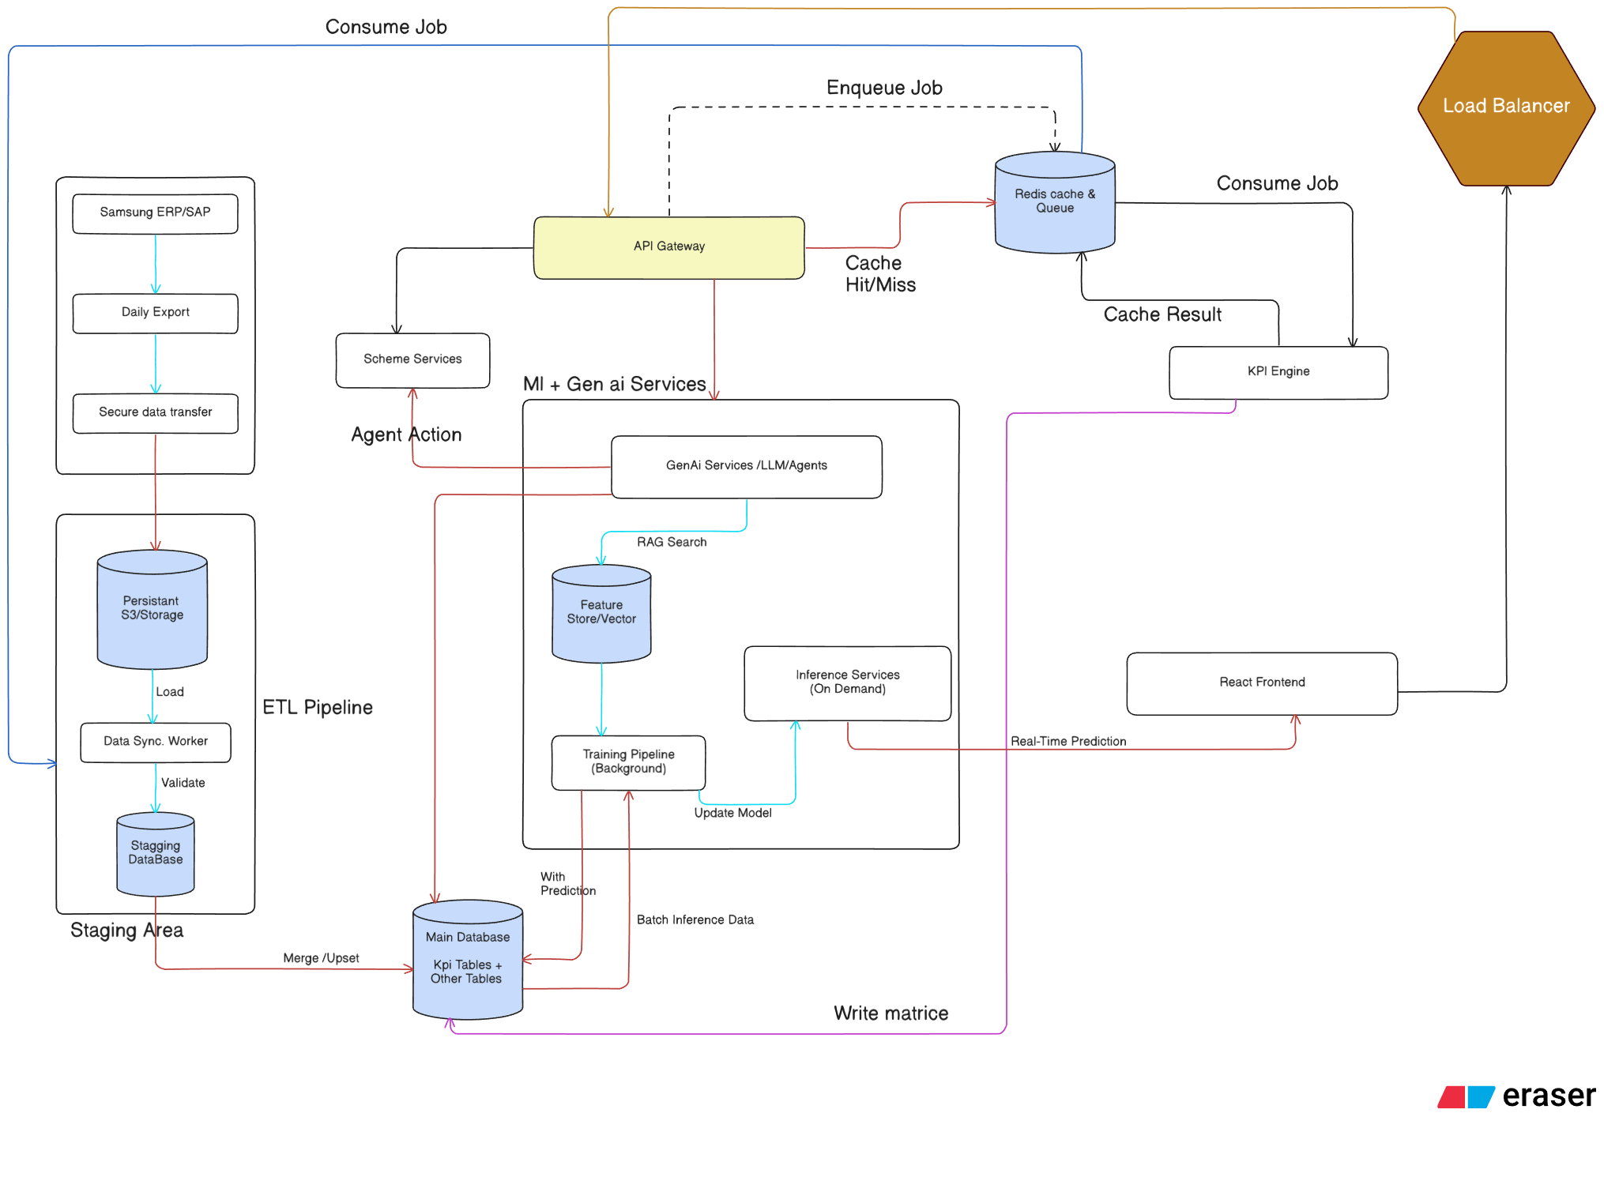


Slide 9
METHODOLOGY
Development Methodology
The project follows a structured, iterative development lifecycle — from initial requirements gathering through to deployment — ensuring each component is validated against real-world enterprise constraints before integration.
Requirements Analysis
1
Stakeholder interviews, use case mapping, and KPI taxonomy definition across dealer operations.
2
Architecture & DB Design
Microservices blueprint, database schema design, and API contract specification.
KPI Pipeline Design
3
ETL workflows, aggregation logic, and real-time computation engine for 299+ indicators.
4
ML Model Development
Feature engineering, model training, validation, and hyperparameter tuning for 14+ models.
AI Agent Orchestration
5
LLM integration, RAG pipeline setup, and multi-agent coordination framework.
6
Frontend & Deployment
React UI development, CI/CD pipeline setup, containerization, and cloud deployment.

Slide 10





CORE MODULES
Platform Core Modules
Simplify Scheme is organized into five tightly integrated modules, each responsible for a distinct layer of the platform's functionality — from raw data ingestion and ML inference to AI reasoning and user-facing dashboards.
ML Service
AI Service
API Gateway
Hosts 14+ trained models for churn prediction, performance forecasting, and anomaly detection. Exposes inference APIs consumed by the AI and API layers.
Orchestrates LLM-powered agents with RAG pipelines. Handles natural-language queries, scheme recommendations, and contextual decision support.
Centralized FastAPI gateway managing authentication, rate limiting, request routing, and inter-service communication across all microservices.
Database & KPI Pipeline
Frontend & Dashboard
PostgreSQL for persistent storage, Redis for caching, and a real-time ETL pipeline computing and updating 299+ KPIs across dealer networks.
React + TypeScript application featuring an interactive scheme designer, live KPI dashboard, and AI copilot chat interface for scheme managers.

Slide 11
KEY HIGHLIGHTS
Current Status & Project Highlights
Simplify Scheme represents a significant advancement in enterprise incentive management — combining production-grade ML, multi-agent AI, and scalable architecture into a unified platform ready for real-world deployment.
299+
14+
5
KPIs Tracked
ML Models
Core Modules
Live indicators across dealer performance, sales, and scheme health
Churn, forecasting, optimization, and anomaly detection models
ML, AI, API Gateway, Data Pipeline, and Frontend Dashboard
🤖 Multi-Agent AI Copilot
🏗️ Enterprise-Grade Scalability
✅ Industry Deployment Ready
LLM-powered agents with RAG provide contextual scheme recommendations and natural-language insights to decision-makers.
Microservices architecture with Redis caching and async APIs ensures high throughput and low-latency performance at scale.
Developed in partnership with Simplify Consulting (India) Pvt. Ltd., aligned with real enterprise requirements and workflows.

Slide 12







PART 2 · IMPLEMENTATION DEPTH
Machine Learning Models Overview
The system is built around seven specialized ML models, each addressing a critical enterprise decision point — from dealer churn and fraud detection to budget optimization and ROI prediction. Together, they form an integrated AI decision layer powering enterprise analytics and decision support at scale.
Churn Prediction
Budget Forecasting
Segmentation
Dealer risk classification
SARIMA time-series projection
Dealer tier clustering
Anomaly Detection
Slab Optimization
Budget Allocation
Fraud and payout scoring
Incentive tier tuning
ROI-aware distribution
ROI Prediction
Scheme return estimation

Slide 13
MODEL M001
Churn Prediction Model
An XGBoost-based gradient boosting classifier predicts dealer churn risk by aggregating signals across five data domains. The model outputs a three-class risk label — ACTIVE, AT_RISK, or HARD_CHURN — enabling proactive retention intervention before revenue impact occurs.
Model Performance
The model achieves high accuracy on held-out dealer data, with strong precision and recall across all three churn classes. Feature importance analysis consistently surfaces financial signals and scheme engagement as top predictors of dealer attrition.
Sales Signals
Financial Signals
Volume trends, sell-through rate, and product mix shifts
Payment cycles, outstanding balances, and credit utilization
Algorithm: XGBoost Classifier
Classes: 3 (ACTIVE / AT_RISK / HARD_CHURN)
Features: 40+ across 5 domains
CRM Signals
Scheme Engagement
Retraining: Monthly incremental refresh
Engagement frequency, support tickets, and relationship depth
Incentive participation, claim rates, and tier progression
Performance Signals
Target attainment, ranking, and peer benchmarking

Slide 14



MODEL M002
Fraud & Anomaly Detection
An Isolation Forest-based unsupervised model continuously scores every claim, invoice, and payout transaction for anomalous behavior. The model does not require labeled fraud cases — it learns the normal distribution of transactional behavior and flags statistical outliers for review.
Suspicious Invoice Patterns
Timing Anomalies
Detects inflated claim amounts, duplicate line items, and unusual invoice frequency that deviate from a dealer's historical norm.
Flags claims submitted outside normal business windows, rapid-fire submissions, or coordinated timing across multiple dealers.
IMEI Duplication
AI Risk Score
Identifies reused or duplicated device identifiers across claims — a strong indicator of organized fraud rings.
Each transaction receives a continuous 0–100 risk score. High-score transactions are routed to compliance teams for manual review with full explainability.

Slide 15
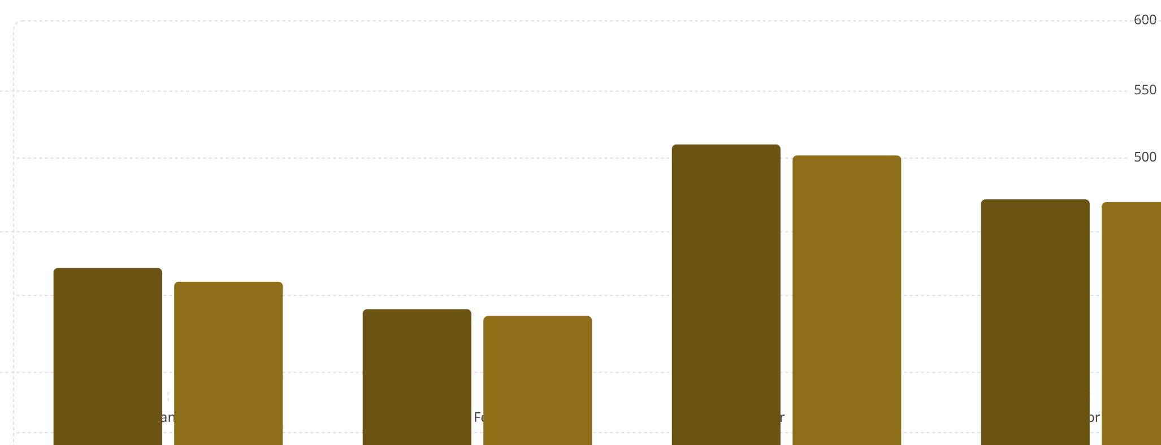
MODELS M003–M005
Budget Forecasting & Optimization
SARIMA Forecasting Engine
SLSQP Budget Allocation
Seasonal ARIMA models project monthly incentive budget requirements across product lines and dealer tiers. The model captures seasonality, trend, and cyclical patterns in historical spend data to generate 12-month rolling forecasts with confidence intervals.
A Sequential Least Squares Programming (SLSQP) optimizer distributes the forecasted budget across dealer tiers to maximize expected ROI while satisfying hard constraints: minimum tier guarantees, maximum per-dealer caps, and compliance rules.
Seasonality
ROI-aware allocation across tiers
Constraint satisfaction (min/max bounds)
Dynamic reallocation on demand signals
Audit trail for every allocation decision
Captures festival, quarter-end, and promotional spikes
Trend
Long-term growth or contraction in scheme participation
Confidence Bounds
95% prediction intervals for risk-aware planning
Forecasted Budget ($K)
Actual Spend ($K)
Forecast accuracy is validated against actual spend monthly, with typical MAPE below 8% across product categories.

Slide 16




AI COPILOT
AI Service & Copilot
A RAG-based natural language assistant enables scheme designers, product managers, and finance teams to query the system in plain English. Responses are grounded in enterprise data — not hallucinated — through retrieval-augmented generation over curated scheme documents, policy repositories, and KPI metadata.
User Query
RAG Retrieval
Natural language question about schemes, budgets, or dealer performance
Relevant documents and KPIs retrieved from vector store via pgvector
LLM Synthesis
Streaming Output
Grounded response generated with citations and data references
Real-time token streaming to UI with low-latency response times
Partner Agent
Product Agent
Dealer and partner queries
Scheme and product intelligence
Budget Agent
ROI Agent
Spend and allocation insights
Return and impact analysis
Compliance Agent
Conflict Agent
Policy and rule checks
Scheme conflict detection

Slide 17





ANALYTICS LAYER
KPI Pipeline Architecture
A five-tier automated KPI pipeline processes raw transactional data into actionable metrics across 299+ KPIs spanning dealer, product, and scheme dimensions. Each tier operates on a distinct cadence, ensuring real-time operational visibility alongside strategic ML-driven insights — dramatically reducing manual reporting effort.
Tier 1 — Daily KPIs
Raw transactional aggregation: sales volume, claim counts, and daily dealer activity snapshots
Tier 2 — Weekly KPIs
Rolling weekly trends, week-over-week deltas, and dealer performance rankings
Tier 3 — Monthly KPIs
Month-end consolidation, scheme attainment, budget utilization, and tier progression
Tier 4 — Statistical KPIs
Correlation matrices, distribution analysis, outlier detection, and trend significance testing
Tier 5 — ML Inference KPIs
Churn scores, fraud risk scores, ROI predictions, and budget optimization outputs
299+
5
1K+
KPI Metrics
Pipeline Tiers
Dealers
Across dealer, product, and scheme dimensions
Daily through ML inference layers
Supported at enterprise scale

Slide 18
INFRASTRUCTURE
Database & Scalability Architecture
Core Data Stack
Enterprise Design Principles
PostgreSQL
pgvector
The data architecture is designed for 1,000+ dealers with millions of monthly transactions. Row-level security enforces data isolation per tenant and dealer tier. Every write operation is logged to an immutable audit table for compliance and forensic analysis.
Primary relational store with normalized schema for dealers, schemes, claims, and budgets
Native vector embeddings for semantic search and RAG retrieval in the AI Copilot
Row-Level Security
Auditability
Per-tenant and per-dealer data isolation enforced at the database level
Full change log with user, timestamp, and before/after values for every mutation
Redis
In-memory caching for KPI pre-computation, session state, and low-latency API responses
Horizontal Scalability
Read replicas and partitioned tables support growth to 10K+ dealers without re-architecture

Slide 19

RESULTS
System Performance & Results
ML Model Benchmarks
Operational Performance
All models have been validated against held-out test sets and benchmarked against baseline approaches. The churn classifier and fraud detector exceed production thresholds for precision and recall, while the forecasting engine maintains low MAPE across seasonal periods.
The system operates as a production-grade platform with sub-second API response times, real-time dashboard updates, and high availability under concurrent enterprise load.
⚡ < 200ms
📊 < 2s
92%
Churn Model Accuracy
Average API inference latency
Dashboard load time (full KPI set)
XGBoost classifier on held-out dealer data
🔄 24/7
✅ 99.9%
88%
Automated pipeline execution
Uptime SLA compliance
Fraud Detection Precision
Isolation Forest anomaly scoring
System has passed production-level stress testing and is operating reliably under enterprise load with 1,000+ active dealers.
91%
Forecast MAPE Score
SARIMA budget projection accuracy

Slide 20




BUSINESS IMPACT
Enterprise Business Impact
Beyond technical performance, the platform delivers measurable business value across every layer of the dealer incentive operation — from faster scheme design cycles to reduced fraud losses and improved dealer retention rates.
Faster Scheme Design
Better Dealer Retention
Fraud Reduction
Intelligent Budget Allocation
AI-assisted scheme creation reduces design cycles from days to hours. The Copilot surfaces comparable historical schemes, recommends slab structures, and flags policy conflicts in real time.
Proactive churn intervention — triggered by M001 risk scores — enables account managers to engage at-risk dealers before attrition occurs, directly improving retention rates and lifetime value.
Automated anomaly scoring catches suspicious claims before payout. The AI risk score reduces manual review volume while increasing fraud capture rates across the dealer network.
ROI-aware SLSQP optimization ensures every dollar of incentive budget is allocated to maximize expected return — replacing heuristic allocation with data-driven, constraint-satisfied decisions.

Slide 21

CONCLUSION & ROADMAP
Conclusion & Future Scope
What We Built
Future Roadmap
This platform represents a fully integrated, AI-driven enterprise decision support system — combining seven production ML models, a five-tier KPI pipeline, a RAG-based AI Copilot, and a scalable PostgreSQL architecture into a single cohesive platform serving 1,000+ dealers.
The platform architecture is designed to evolve. The following capabilities are planned for the next development phases:
Real-Time Streaming Analytics
01
Kafka-based event streaming for sub-minute KPI updates and live churn scoring
ML-Powered Decisioning
Churn, fraud, forecasting, and ROI models operating in production
Federated Learning
Privacy-preserving model training across dealer networks without centralizing sensitive data
02
Automated Analytics
Reinforcement Learning
299+ KPIs across 5 pipeline tiers with zero manual effort
Dynamic scheme optimization through closed-loop reward signals from dealer behavior
03
AI Copilot Interface
NL2SQL Query Engine
Natural language access to enterprise data and scheme intelligence
Natural language to SQL translation for ad-hoc analyst queries without SQL expertise
04
Computer Vision for Fraud
Enterprise Scalability
Document image analysis to detect forged invoices, tampered receipts, and manipulated claim evidence
Row-level security, auditability, and horizontal scaling to 10K+ dealers
Thank you for your attention. This platform demonstrates that enterprise AI — when architected with rigor — delivers measurable, scalable, and defensible business value.

